Slide 1


Presentation on
COVID-19 Global Insight Dashboard
Presented By:
Guided By:
Suryakant Barik
Dibyaprasad Sahu
Monalisha Sahoo
Abhishek Panda
Satyam Sahu
Miss. Gitanjali Digal

Slide 2
INTRODUCTION
This project analyzes global COVID-19 data through three key sections:
Country-wise Data: Provides detailed statistics on confirmed cases, deaths, recoveries, and regional trends for each country.
Global Analysis: Summarizes worldwide totals, recovery and death rates, and compares regional and country-specific metrics.
Dashboard: Designed for visual representation of the data, though currently empty.
The aim is to offer clear insights into the spread and impact of COVID-19 across countries and regions.

Slide 3
PROJECT OVERVIEW
📈 Identify Key Trends
Highlighted top affected countries based on confirmed, death, and recovery cases using heatmaps and bar charts.
🗺 Visualize Impact
Created region-wise charts and WHO regional distributions to assess the spread and response across continents.
🤖 Predictive Modeling
Explored linear regression techniques to understand weekly case changes and forecast future trends.
💡 Actionable Insights
Delivered visual insights through dashboards and graphs for better public health understanding and decisions.

Slide 4
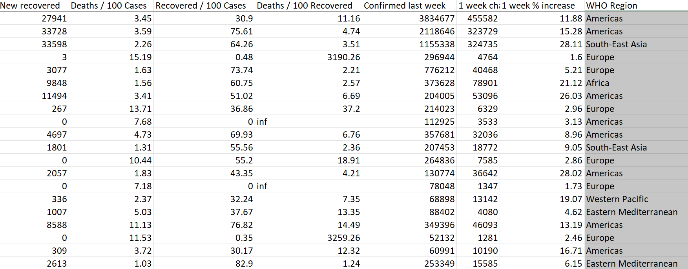
PROJECT DESCRIPTION
This presentation provides a data-driven overview of the global COVID-19 situation. It includes country-specific case statistics, global trends in recovery and mortality, and comparative regional analysis. The goal is to highlight the pandemic's impact through clear, concise insights supported by reliable data.

Slide 5
PROBLEM STATEMENT
The COVID-19 pandemic has had a profound global impact, but understanding its spread and severity across different countries and regions remains complex. Inconsistent data reporting, varying healthcare responses, and diverse population dynamics create challenges in drawing meaningful comparisons.
This project aims to consolidate and analyze global COVID-19 data to provide a clear, comparative insight into the pandemic's progression and its regional effects.
The goal is to empower decision-makers, researchers, and the public with clear trends, comparisons, and forecasts.

Slide 6






METHODOLOGY & APPROACH
Data Processing
Cleaning & preparing data in Excel for accuracy.
Metric Derivation
Calculating key metrics like survival & test-confirmed ratios.
Trend Analysis
Using Multiple Linear Regression(MLR) for trend identification.
Visualizations
Creating line graphs, maps & heatmaps in Tableau & Excel.
Data Processing
Cleaning & preparing data in Excel for accuracy.

Slide 7
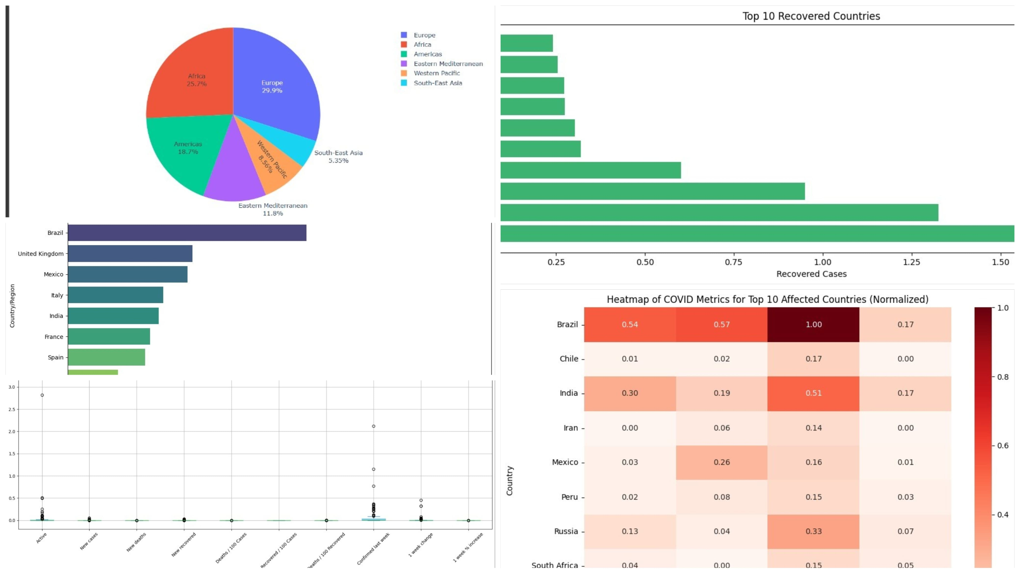
OVERVIEW OF THE ML PROJECT

Slide 8
EXPLANATION OF THE ML PROJECT
Pie Chart
Country Distribution by WHO Region.
Why use it: A pie chart provides a quick view of how countries are grouped regionally under WHO.
What it tells us: This chart highlights which WHO regions contain the most member countries, offering perspective on geographical focus and global public health governance.
Insight: Regions like Africa and Europe have large shares of member nations, indicating areas where regional health coordination is crucial.
Bar Chart
Top 10 Countries by Recovered Cases.
Why use it: Recovery data indicates the efficiency and effectiveness of a country's healthcare and pandemic response.
What it tells us: This graph shows which countries managed to recover the most patients — possibly due to strong healthcare systems, mass testing, or early intervention.
Insight: Some countries appear both in high death and high recovery charts, revealing the dual burden of high case volume and effective treatment.

Slide 9
EXPLANATION OF THE ML PROJECT
Bar Chart
Top 10 Countries by Deaths.
Why use it: A horizontal bar chart clearly compares absolute death counts across countries.
What it tells us: Countries like the USA, India, and Brazil have the highest number of reported COVID-19 deaths. This graph helps identify where the pandemic had the most severe human Cost.
Insight: The large gap between top countries and others highlights healthcare strain, possible delays in intervention, or higher population vulnerability.
Heatmap
COVID Metrics Across Top 10 Affected Countries.
Why use it: A heatmap allows for quick visual comparison across multiple metrics (Confirmed, Deaths, Recovered, Active).
What it tells us: The normalized heatmap shows relative intensity — for example, which countries have the highest ratio of active or recovered cases.
Insight: You can identify countries where deaths are disproportionately high or recovery rates are significantly better, helping evaluate crisis management and public health policies.

Slide 10
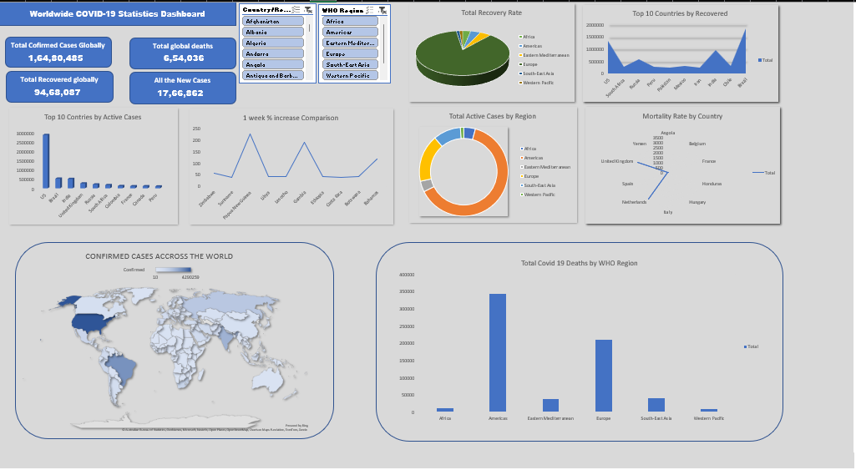
OVERVIEW OF EXCEL DASHBOARD

Slide 11
EXPLANATION OF EXCEL DASHBOARD
This Excel dashboard presents a global analysis of COVID-19 data. It includes country-wise statistics such as confirmed cases, deaths, recoveries, and active cases, along with daily and weekly trends.
The analysis sheet summarizes key global metrics—like total cases, death and recovery rates—and breaks them down by WHO regions. This data helps identify the most affected areas and overall pandemic trends for better decision-making and visualization.
This Excel dashboard presents a global analysis of COVID-19 data. It includes country-wise statistics such as confirmed cases, deaths, recoveries, and active cases, along with daily and weekly trends. The analysis sheet summarizes key global metrics—like total cases, death and recovery rates—and breaks them down by WHO regions.
This data helps identify the most affected areas and overall pandemic trends for better decision-making and visualization.

Slide 12
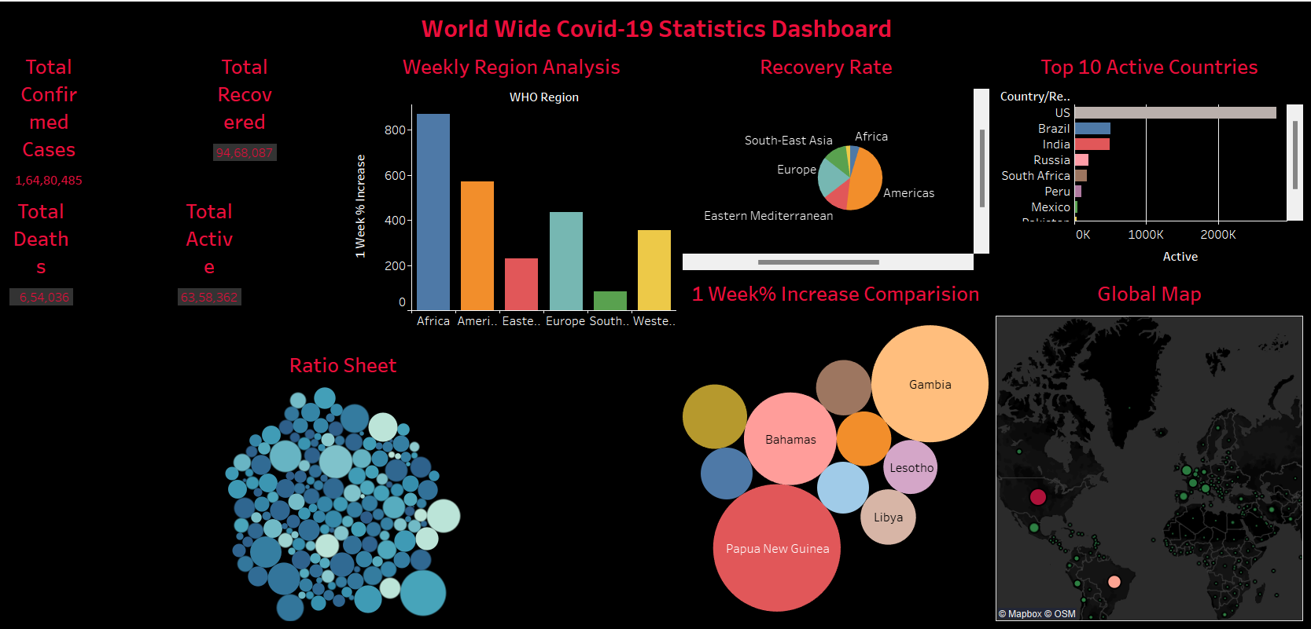
OVERVIEW OF TABLEAU DASHBOARD

Slide 13
EXPLANATION OF TABLEAU DASHBOARD
The Tableau dashboard provides a visual overview of the global impact of COVID-19, focusing on key statistics like confirmed cases, deaths, recoveries, and active cases. It shows,
Total Confirmed Cases-16.48 million,
Total Deaths: 654,036 (Death Rate \~3.97%),
Total Recoveries: 9.47 million (Recovery Rate \~57.45%).
The dashboard also includes regional comparisons (e.g., Africa, Europe) based on recovery rates, death rates, and active case counts. It helps identify trends and regional differences, supporting better decision-making for health responses and policy planning.

Slide 14
CONCLUSION
This project provided a comprehensive analysis of global COVID-19 data using both Excel, Tableau & ML. Through detailed country-wise statistics and regional comparisons, we uncovered patterns in infection rates, recovery trends, and mortality across different parts of the world.
Tableau visualizations enhanced the clarity and impact of these insights, making the data more accessible and easier to interpret.
By integrating data analysis with interactive dashboards, this project not only highlighted key health metrics but also demonstrated the power of visual storytelling in understanding global health crises.

Slide 15


